Slide 1

III Semester AY 2024-25
Subject: Project management with Git
Subject Code: BCS358C
Introduction to Git
Dr. Rama Krishna K
Prof. & Head,
Dept. AI & ML,
ICEAS

Slide 2
Introduction to GiT
Git is a modern and widely used distributed version control system in the world. It is developed to manage projects with high speed and efficiency.
The version control system allows us to monitor and work together with our team members at the same workspace.
This tutorial will help you to understand the distributed version control system Git via the command line as well as with GitHub.
The examples in this tutorial are performed on Windows, but we can also perform same operations on other operating systems like Linux (Ubuntu) and MacOS.
Notes:
credential:
bring a computer
die photo
wafer
:
This can be an hidden slide. I just want to use this to do my own planning.
I have rearranged Culler’s lecture slides slightly and add more slides. This covers everything he covers in his first lecture (and more) but may
We will save the fun part, “ Levels of Organization,” at the end (so student can stay awake): I will show the internal stricture of the SS10/20.
Notes to Patterson: You may want to edit the slides in your section or add extra slides to taylor your needs.

Slide 3
More About GiT
Git was developed to work on the Linux kernel; therefore, it is capable enough to handle large repositories effectively. From the beginning, speed and performance have been Git's primary goals.
Supports non-linear development Git supports seamless branching and merging, which helps in visualizing and navigating a non-linear development. A branch in Git represents a single commit.
We can construct the full branch structure with the help of its parental commit.
Branching and Merging
Branching and merging are the great features of Git, which makes it different from the other SCM tools.
Git allows the creation of multiple branches without affecting each other.
We can perform tasks like creation, deletion, and merging on branches, and these tasks take a few seconds only.

Slide 4
More About GiT
Below are some features that can be achieved by branching:
We can create a separate branch for a new module of the project, commit and delete it whenever we want.
We can have a production branch, which always has what goes into production and can be merged for testing in the test branch.
We can create a demo branch for the experiment and check if it is working. We can also remove it if needed.
The core benefit of branching is if we want to push something to a remote repository, we do not have to push all of our branches.
We can select a few of our branches, or all of them together

Slide 5
More About GiT
Data Assurance
The Git data model ensures the cryptographic integrity of every unit of our project. It provides a unique commit ID to every commit through a SHA algorithm.
We can retrieve and update the commit by commit ID. Most of the centralized version control systems do not provide such integrity by default.
Staging Area
The Staging area is also a unique functionality of Git. It can be considered as a preview of our next commit, moreover, an intermediate area where commits can be formatted and reviewed before completion. When you make a commit, Git takes changes that are in the staging area and make them as a new commit.
We are allowed to add and remove changes from the staging area. The staging area can be considered as a place where Git stores the changes.

Slide 6
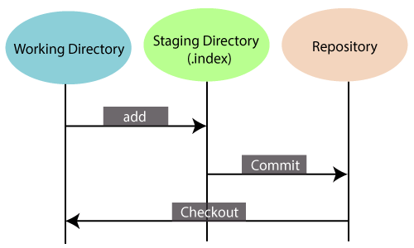
More About GiT
Although, Git doesn't have a dedicated staging directory where it can store some objects representing file changes (blobs). Instead of this, it uses a file called index.
Another feature of Git that makes it apart from other SCM tools is that it is possible to quickly stage some of our files and commit them without committing other modified files in our working directory.
Maintain the clean history
Git facilitates with Git Rebase; It is one of the most helpful features of Git. It fetches the latest commits from the master branch and puts our code on top of that. Thus, it maintains a clean history of the project.

Slide 7
What is Git?
Git is an open-source distributed version control system.
It is designed to handle minor to major projects with high speed and efficiency.
It is developed to co-ordinate the work among the developers.
The version control allows us to track and work together with our team members at the same workspace.
Git is foundation of many services like GitHub and GitLab, but we can use Git without using any other Git services.
Git can be used privately and publicly.
Git was created by Linus Torvalds in 2005 to develop Linux Kernel. It is also used as an important distributed version-control tool for the DevOps.
Git is easy to learn, and has fast performance. It is superior to other SCM tools like Subversion, CVS, Perforce, and ClearCase.
Notes:
credential:
bring a computer
die photo
wafer
:
This can be an hidden slide. I just want to use this to do my own planning.
I have rearranged Culler’s lecture slides slightly and add more slides. This covers everything he covers in his first lecture (and more) but may
We will save the fun part, “ Levels of Organization,” at the end (so student can stay awake): I will show the internal stricture of the SS10/20.
Notes to Patterson: You may want to edit the slides in your section or add extra slides to taylor your needs.

Slide 8
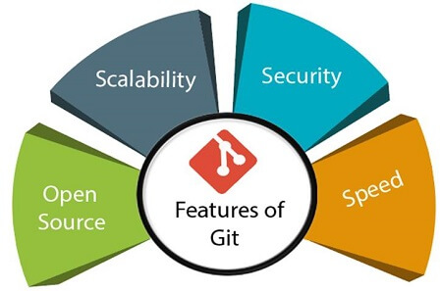
Features of Git
Notes:
credential:
bring a computer
die photo
wafer
:
This can be an hidden slide. I just want to use this to do my own planning.
I have rearranged Culler’s lecture slides slightly and add more slides. This covers everything he covers in his first lecture (and more) but may
We will save the fun part, “ Levels of Organization,” at the end (so student can stay awake): I will show the internal stricture of the SS10/20.
Notes to Patterson: You may want to edit the slides in your section or add extra slides to taylor your needs.

Slide 9
Features of Git
Open Source Git is an open-source tool. It is released under the GPL (General Public License) license.
Scalable Git is scalable, which means when the number of users increases, the Git can easily handle such situations.
Distributed One of Git's great features is that it is distributed. Distributed means that instead of switching the project to another machine, we can create a "clone" of the entire repository.
Also, instead of just having one central repository that you send changes to, every user has their own repository that contains the entire commit history of the project. We do not need to connect to the remote repository; the change is just stored on our local repository. If necessary, we can push these changes to a remote repository
Notes:
credential:
bring a computer
die photo
wafer
:
This can be an hidden slide. I just want to use this to do my own planning.
I have rearranged Culler’s lecture slides slightly and add more slides. This covers everything he covers in his first lecture (and more) but may
We will save the fun part, “ Levels of Organization,” at the end (so student can stay awake): I will show the internal stricture of the SS10/20.
Notes to Patterson: You may want to edit the slides in your section or add extra slides to taylor your needs.

Slide 10
Features of Git
Security
Git is secure. It uses the SHA1 (Secure Hash Function) to name and identify objects within its repository. Files and commits are checked and retrieved by its checksum at the time of checkout.
It stores its history in such a way that the ID of particular commits depends upon the complete development history leading up to that commit. Once it is published, one cannot make changes to its old version.
Speed
Git is very fast, so it can complete all the tasks in a while.
Most of the git operations are done on the local repository, so it provides a huge speed. Also, a centralized version control system continually communicates with a server somewhere.
Performance tests conducted by Mozilla showed that it was extremely fast compared to other VCSs.
Fetching version history from a locally stored repository is much faster than fetching it from the remote server. The core part of Git is written in C, which ignores runtime overheads associated with other high-level languages.

Slide 11
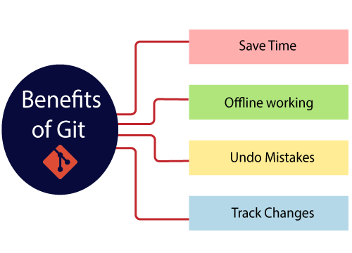
Benefits of Git
A version control application allows us to keep track of all the changes that we make in the files of our project.
Every time we make changes in files of an existing project, we can push those changes to a repository.
Other developers are allowed to pull your changes from the repository and continue to work with the updates that you added to the project files.
Some significant benefits of using Git are as follows:
Notes:
credential:
bring a computer
die photo
wafer
:
This can be an hidden slide. I just want to use this to do my own planning.
I have rearranged Culler’s lecture slides slightly and add more slides. This covers everything he covers in his first lecture (and more) but may
We will save the fun part, “ Levels of Organization,” at the end (so student can stay awake): I will show the internal stricture of the SS10/20.
Notes to Patterson: You may want to edit the slides in your section or add extra slides to taylor your needs.

Slide 12
Benefits of Git
Saves Time
Git is lightning fast technology. Each command takes only a few seconds to execute so we can save a lot of time as compared to login to a GitHub account and find out its features.
Offline Working
One of the most important benefits of Git is that it supports offline working. If we are facing internet connectivity issues, it will not affect our work. In Git, we can do almost everything locally. Comparatively, other CVS like SVN is limited and prefer the connection with the central repository.
Undo Mistakes
One additional benefit of Git is we can Undo mistakes. Sometimes the undo can be a savior option for us. Git provides the undo option for almost everything.
Track the Changes
Git facilitates with some exciting features such as Diff, Log, and Status, which allows us to track changes so we can check the status, compare our files or branches.
Notes:
credential:
bring a computer
die photo
wafer
:
This can be an hidden slide. I just want to use this to do my own planning.
I have rearranged Culler’s lecture slides slightly and add more slides. This covers everything he covers in his first lecture (and more) but may
We will save the fun part, “ Levels of Organization,” at the end (so student can stay awake): I will show the internal stricture of the SS10/20.
Notes to Patterson: You may want to edit the slides in your section or add extra slides to taylor your needs.

Slide 13
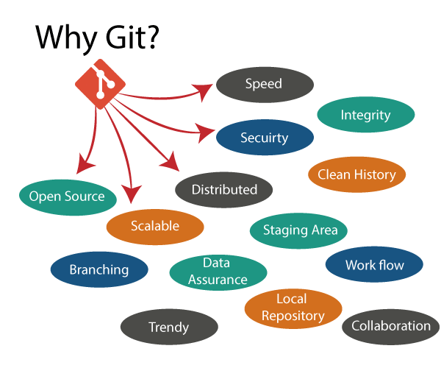
Why Git?
Notes:
credential:
bring a computer
die photo
wafer
:
This can be an hidden slide. I just want to use this to do my own planning.
I have rearranged Culler’s lecture slides slightly and add more slides. This covers everything he covers in his first lecture (and more) but may
We will save the fun part, “ Levels of Organization,” at the end (so student can stay awake): I will show the internal stricture of the SS10/20.
Notes to Patterson: You may want to edit the slides in your section or add extra slides to taylor your needs.

Slide 14
Why Git?
Git Integrity
Git is developed to ensure the security and integrity of content being version controlled. It uses checksum during transit or tampering with the file system to confirm that information is not lost. Internally it creates a checksum value from the contents of the file and then verifies it when transmitting or storing data.
Trendy Version Control System
Git is the most widely used version control system. It has maximum projects among all the version control systems. Due to its amazing workflow and features, it is a preferred choice of developers.
Everything is Local
Almost All operations of Git can be performed locally; this is a significant reason for the use of Git. We will not have to ensure internet connectivity.
.
Notes:
credential:
bring a computer
die photo
wafer
:
This can be an hidden slide. I just want to use this to do my own planning.
I have rearranged Culler’s lecture slides slightly and add more slides. This covers everything he covers in his first lecture (and more) but may
We will save the fun part, “ Levels of Organization,” at the end (so student can stay awake): I will show the internal stricture of the SS10/20.
Notes to Patterson: You may want to edit the slides in your section or add extra slides to taylor your needs.

Slide 15
Why Git?
Collaborate to Public Projects
There are many public projects available on the GitHub. We can collaborate on those projects and show our creativity to the world. Many developers are collaborating on public projects.
The collaboration allows us to stand with experienced developers and learn a lot from them; thus, it takes our programming skills to the next level.
Impress Recruiters
We can impress recruiters by mentioning the Git and GitHub on our resume. Send your GitHub profile link to the HR of the organization you want to join. Show your skills and influence them through your work.
Notes:
credential:
bring a computer
die photo
wafer
:
This can be an hidden slide. I just want to use this to do my own planning.
I have rearranged Culler’s lecture slides slightly and add more slides. This covers everything he covers in his first lecture (and more) but may
We will save the fun part, “ Levels of Organization,” at the end (so student can stay awake): I will show the internal stricture of the SS10/20.
Notes to Patterson: You may want to edit the slides in your section or add extra slides to taylor your needs.

Slide 16
What is GitHub?
GitHub is a Git repository hosting service. GitHub also facilitates with many of its features, such as access control and collaboration. It provides a Web-based graphical interface.
GitHub is an American company.
It hosts source code of your project in the form of different programming languages and keeps track of the various changes made by programmers.
It offers both distributed version control and source code management (SCM) functionality of Git. It also facilitates with some collaboration features such as bug tracking, feature requests, task management for every project
Notes:
credential:
bring a computer
die photo
wafer
:
This can be an hidden slide. I just want to use this to do my own planning.
I have rearranged Culler’s lecture slides slightly and add more slides. This covers everything he covers in his first lecture (and more) but may
We will save the fun part, “ Levels of Organization,” at the end (so student can stay awake): I will show the internal stricture of the SS10/20.
Notes to Patterson: You may want to edit the slides in your section or add extra slides to taylor your needs.

Slide 17
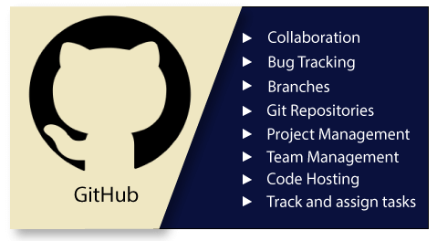
Notes:
credential:
bring a computer
die photo
wafer
:
This can be an hidden slide. I just want to use this to do my own planning.
I have rearranged Culler’s lecture slides slightly and add more slides. This covers everything he covers in his first lecture (and more) but may
We will save the fun part, “ Levels of Organization,” at the end (so student can stay awake): I will show the internal stricture of the SS10/20.
Notes to Patterson: You may want to edit the slides in your section or add extra slides to taylor your needs.

Slide 18
Features of GitHub
GitHub is a place where programmers and designers work together. They collaborate, contribute, and fix bugs together. It hosts plenty of open source projects and codes of various programming languages.
Some of its significant features are as follows.
o Collaboration
o Integrated issue and bug tracking
o Graphical representation of branches
o Git repositories hosting
o Project management
o Team management
o Code hosting
o Track and assign tasks
o Conversations
o Wikisc
Notes:
credential:
bring a computer
die photo
wafer
:
This can be an hidden slide. I just want to use this to do my own planning.
I have rearranged Culler’s lecture slides slightly and add more slides. This covers everything he covers in his first lecture (and more) but may
We will save the fun part, “ Levels of Organization,” at the end (so student can stay awake): I will show the internal stricture of the SS10/20.
Notes to Patterson: You may want to edit the slides in your section or add extra slides to taylor your needs.

Slide 19
Benefits of GitHub
GitHub can be separated as the Git and the Hub. GitHub service includes access controls as well as collaboration features like task management, repository hosting, and team management.
The key benefits of GitHub are as follows.
It is easy to contribute to open source projects via GitHub.
It helps to create an excellent document.
You can attract recruiter by showing off your work. If you have a profile on GitHub, you will have a higher chance of being recruited.
It allows your work to get out there in front of the public.
You can track changes in your code across versions.
Notes:
credential:
bring a computer
die photo
wafer
:
This can be an hidden slide. I just want to use this to do my own planning.
I have rearranged Culler’s lecture slides slightly and add more slides. This covers everything he covers in his first lecture (and more) but may
We will save the fun part, “ Levels of Organization,” at the end (so student can stay awake): I will show the internal stricture of the SS10/20.
Notes to Patterson: You may want to edit the slides in your section or add extra slides to taylor your needs.

Slide 20
Difference between git and gitHub
Self Learning Topic for students
Download Git : https://git-scm.com/download/win

